Slide 1
Session 18: UI App
Code For Teens
TechKids

Slide 2
Previously on C4T
JS Objects
JS Functions
DOM

Slide 3
Agenda
RGB Color
Demo
Requirement Breakdown
Implementation

Slide 4
RGB
How many colors does natural light consist of?

Slide 5
R
G
B

Slide 6
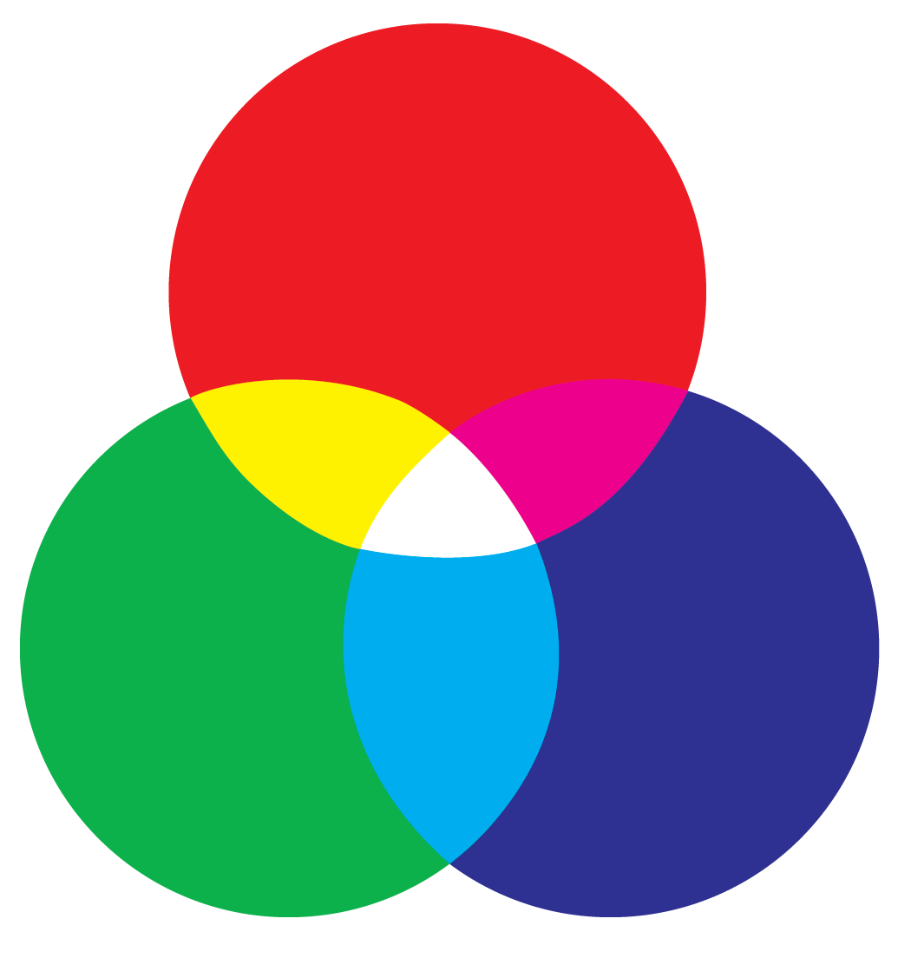
R
G
B

Slide 7
Value range
From 0 to 255

Slide 8
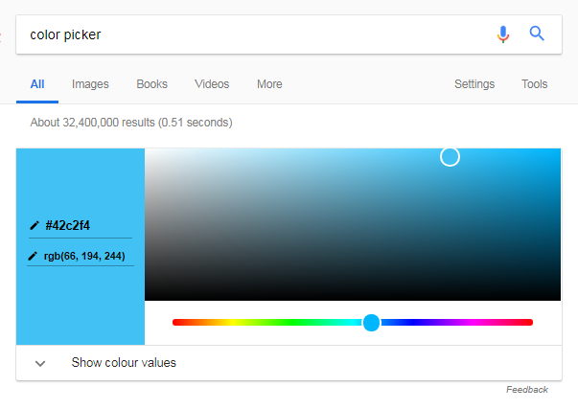
Google’s color picker

Slide 9
App demo

Slide 10
Requirements breakdown

Slide 11
Requirements breakdown
Generate color balls
Update score based on what users click

Slide 12
Generate color balls

Slide 13
Generate color balls
RGB(158, 177, 96)
Generate the right color
Generate wrong colors
Ball orders must be random
Right ball must be recognized later
Must be able to run at multiple points of time
RGB(113, 83, 161)
Functions!!!

Slide 14
Calculate score

Slide 15
Calculate score
When users click on one of the balls
Right color => increase score
RGB(113, 83, 161)
SCORE: 2

Slide 16
Calculate score
When users click on one of the balls
Right color => increase score
Wrong color => reset score
RGB(113, 83, 161)
SCORE: 3

Slide 17
Calculate score
When users click on one of the balls
Right color => increase score
Wrong color => reset score
RGB(113, 83, 161)
SCORE: 0

Slide 18
This is NOT the full version

Slide 19
Implementation

Slide 20
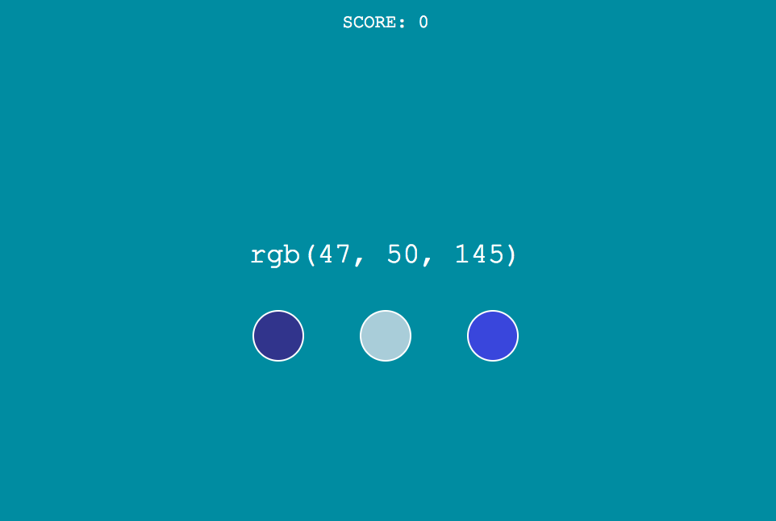

Slide 21
Random range
x = Math.random()
x: From 0 to 1
255 * x: From 0 to 255

Slide 22
String formatting
var nBurger = 1;
var nCoke = 2;
var s = `I want ${nBurger} burgers and ${nCoke} cokes`;

Slide 23
Next steps

Slide 24
Next steps
Sound effect
Timeout
Show right answers
Other UI apps & games

Slide 25
Sound effect
Audio

Slide 26
Timeout
setInterval()

Slide 27
Show right answer

Slide 28
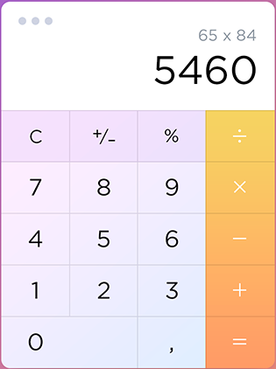
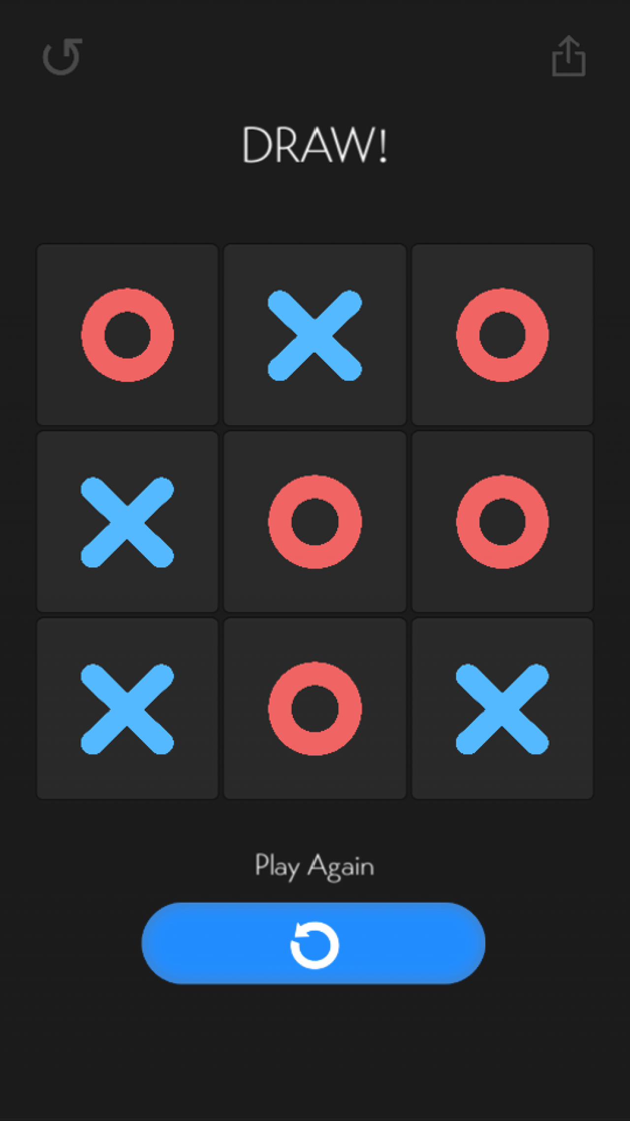
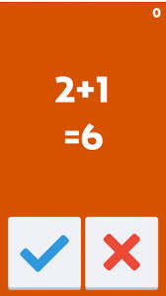
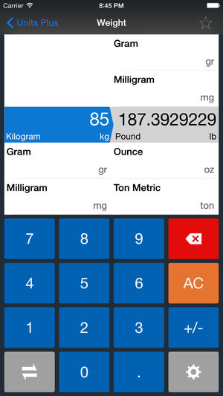
Other UI apps & games

